Slide 1
ZOMATO
A Case Study
- By Ankur Bhatia

Slide 2
Introduction
This presentation will help us to understand the trends in Restaurants over different Countries which will help us to take decisions upon opening of new Restaurants
For this, we would be using the data of 9 Years from 2010-2018
We would be comparing Number Of Restaurants, Ratings, Expenditures, Cuisines etc. in each country to get the valuable insights.

Slide 3
SELECTION OF COUNTRIES
We will try to find suitable countries to open our new Restaurant on the basis of :
Number of Restaurants already present in countries
Expenditure
Ratings of Restaurants

Slide 4
According to this chart, it is clear that INDIA and USA has most number of Restaurants, so we will exclude these as higher number of restaurants will result in more competition.
Countries based on Count of Restauarants
Canada
Qatar
Singapore
Sri Lanka
Indonesia
Philippines
Australia
Turkey
New Zealand
Brazil
United Arab Emirates
South Africa
United Kingdom

Slide 5
According to below chart, we can see that from Canada to Singapore ,the Expenditure is quite high. So, keeping in mind the expenditure also, we would further filter out the countries.
Countries based on Expenditure
Turkey
Sri Lanka
Indonesia
South Africa
Australia
Brazil

Slide 6
According to below chart, we can conclude:
South Africa, Brazil and Turkey have the most ratings in Excellent and Very Good Category. This means that people prefer eating in these countries and give better ratings to food

Slide 7
According to our analysis on Number Of Restaurants ,Expenditure and Rating Distribution across countries, we would be interested in below countries for further analysis
SOUTH AFRICA
BRAZIL
TURKEY

Slide 8

CITIES
Now as we have selected our countries, its time to look for the cities
We will follow similar approach to drill down to find suitable cities to open new restaurant
We will compare the Count Of Restaurants and Ratings given by customers

Slide 10
With the help of previous 2 charts we can conclude that
Cities with Highest Count of Restaurants : Sao Paulo , Rio de Janeiro , Brasilia ,Cape Town, Pretoria , Ankara
Cities with Lowest Count of Restaurants : Randburg, Inner City, Johannesburg
Now, looking at the ratings, Rio De Janeiro , Ankara , Pretoria, Cape Town stand out High.
So by considering these 2 factors, we can filter out below suitable cities for our expansion:
Rio De Janeiro
Ankara
Pretoria

Slide 11

DIVING DEEP
Now as we have selected our countries, we will start our further analysis on points like:
Cuisines serving in restaurants
Ratings distribution
Availability of Online Delivery
Availability of Online Table Booking

Slide 12


RATINGS
1-2 | BAD
2-3 | GOOD
3-4 | VERY GOOD
4-5 | EXCELLENT
We have created the Ratings Bucket as per the table shown
So, the least Rating is BAD and the best Rating is EXCELLENT!
We will see how ratings are behaving according to the countries we have selected.
This will help us to see what type of reviews customers are giving in our countries

Slide 13
All 3 countries have most of the ratings under EXCELLENT category
They are also doing great under VERY GOOD category
There are few BAD ratings in BRAZIL only which we can neglect.

Slide 14

CUISINES
Cuisines are the most important factor need to be considered while opening a Restaurant
More the popular Cuisines, more it will attract Customers.
So, we will try to find out, which Cuisines are most popular in these countries.
We will determine this on the basis of counts of EXCELLENT ratings provided by customers

Slide 15
These are the Cuisines which have most Excellent ratings from customers in our preferred countries
We can start our restaurant with these 5 Cuisines.

Slide 16
We have compared Excellent Rating with our Price Range Of Cuisines and found that most of the Excellent Ratings fall under Price Range of 3 and 4
This indicates that we can have Price Range High in our restaurants

Slide 17

ONLINE TABLE BOOKING
In this era of Online World, it is crucial to keep Online options available for the customers
Customers would be happier if they could book a table just by sitting at home.
Lets see the general trend of Online Table Booking in our selected countries.

Slide 18
According to the chart, we can see that most of the restaurants DO NOT provide the Online Table Booking option
So if we introduce this feature in our new restaurant ,then its more likely to attract more customers

Slide 19

ONLINE DELIVERY
Online Delivery is also one of the major factors in increasing the revenue of a restaurant
Online Delivery helps restaurants to increase their reach and number of customers
We will see how much restaurants are providing this facility in our selected countries

Slide 20
According to the chart, we can see that NONE of the restaurants provide Online Delivery
So, it would be really beneficial for our restaurant if we can provide Online Delivery facility in these countries.

Slide 21

CONCLUSION
Countries to be considered :
Cities to be considered
SOUTH
AFTRICA
BRAZIL
TURKEY
Rio De Janeiro
Ankara
Pretoria

Slide 22
CONCLUSION
We should provide Online Table Booking facility in our new restaurant
We should provide Online Delivery facility also
We can serve following cuisines in our new restaurant
Café
Brazilian
Brazilian bar food
We can go for the Higher Price Range as well for our Cuisines.

Slide 23
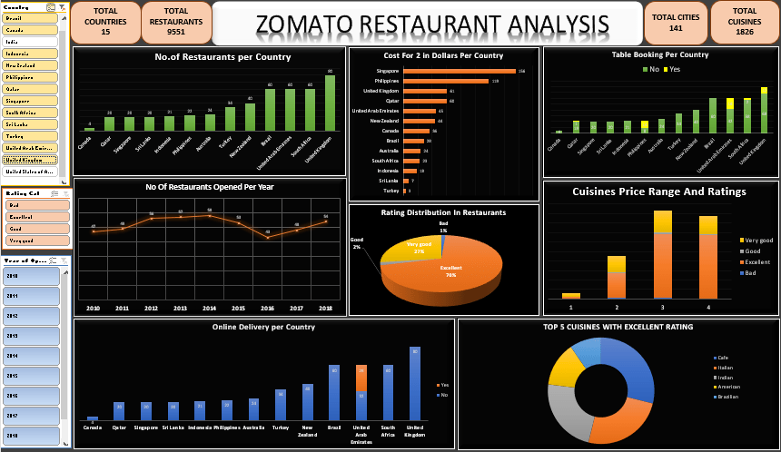

Slide 24
Thank you

